Slide 1

Predicting PSLE Scores
Koh Pi Rong
C2202088

Slide 2
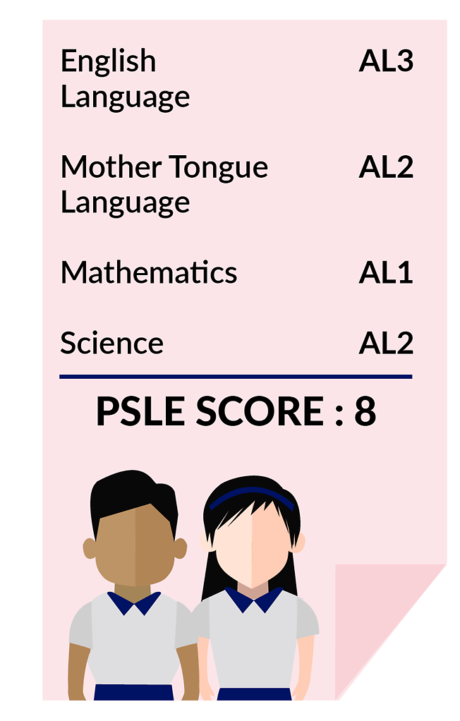
Problem Statement
As the Ministry of Education shifts to a less competitive education system, a system using Achievement Levels (ALs) has been introduced.
Each AL represents a range of scores, and a student’s PSLE score is the ALs for their 4 subjects combined. Each school accepts students below a certain AL.
We can use machine learning regression to predict AL scores for schools, using the school’s characteristics.

Slide 3
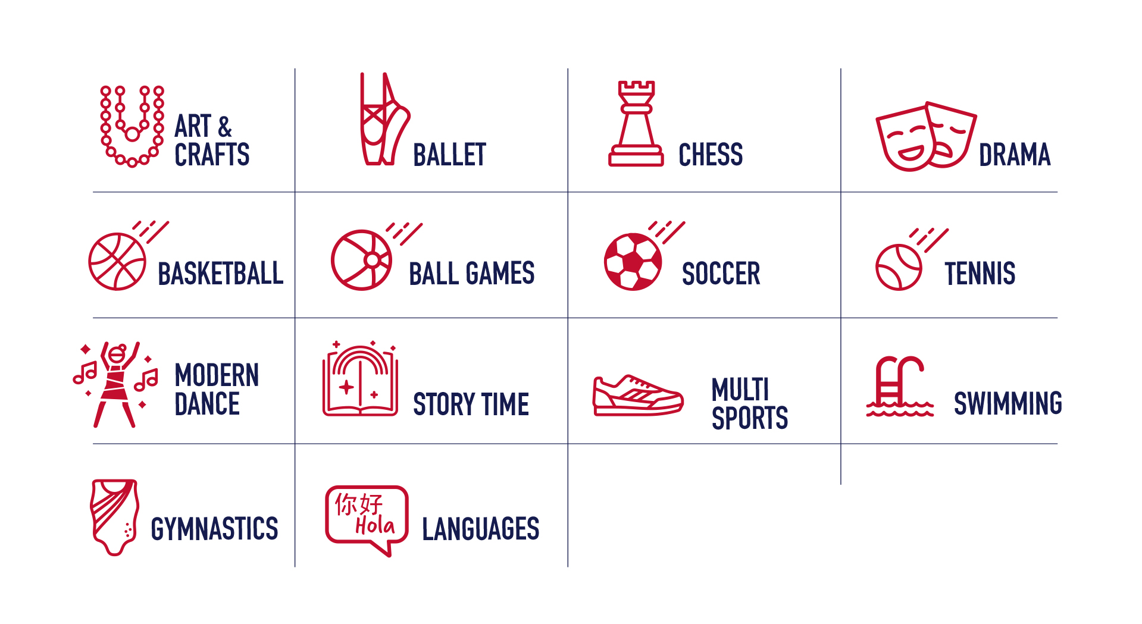

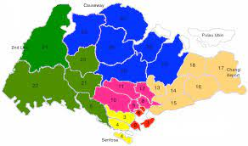
Data Exploration
2 datasets were obtained from data.gov.sg and the Ministry Of Education website -
School Directory and Information
Contains information about schools, such as subjects offered, CCAs, bus connections, general location
Indicative PSLE Score Range of 2020
Contains information about the likely PSLE score ranges for current schools
Challenge 1
Notes:
School Directory and Information: https://data.gov.sg/dataset/school-directory-and-information
Indicative PSLE Score Range of 2020: https://www.moe.gov.sg/microsites/psle-fsbb/assets/infographics/transition-to-secondary-school/indicative-psle-score-ranges-for-individual-secondary-schools.pdf
https://www.sais.edu.sg/curriculum/early-years-learning/enrichment-activities-all-under-one-roof/

Slide 4
Data Processing
Secondary schools entries were identified and other entries were filtered out.
Descriptive data such as names of CCAs and subjects offered were converted into numerical terms.
The spreadsheet with indicative PSLE scores (y-values) was combined into the main dataset.
Removing Unused Data
Dropping Unused Features
Quantifying Descriptive Data
One-Hot Encoding
Combining Datasets
Features such as address, names of principals were removed.
Features such as general location (NSEW) was one-hot encoded.*
*Note that one-hot encoding was done in the main workbook prior to model building.

Slide 5
Methods
Different machine learning algorithms were used to find the best model. They include -
Linear Regression
Ensemble Learning (with and without Grid Search)
Decision Tree Regression
K-Nearest Neighbours

Slide 6
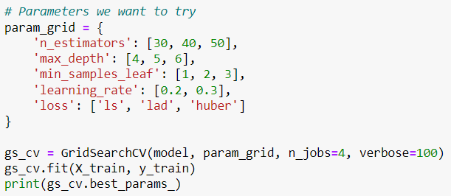
Hyperparameter Tuning
GridSearch was used to obtain the best hyperparameters for ensemble learning. The best parameters are highlighted on the table.
Number Of Estimators | 30 | 40 | 50
Maximum Tree Depth | 4 | 5 | 6
Minimum Leaf Samples | 1 | 2 | 3
Learning Rate | 0.2 |  | 0.3
Loss Function | ls | lad | huber

Slide 7


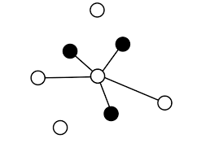
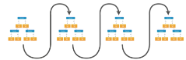

Comparison Of Models
Of the models being used, the ensemble learning model using hyperparameters tuned with GridSearch outperformed the rest by a large margin.
Algorithm Used | Linear Regression | Ensemble Learning (Default) | Ensemble Learning (with GridSearch) | Decision Tree Regression | K-Nearest Neighbours
Training Set Error* | 1.79 | 0.79 | 0.73 | NA | 2.45
Test Set Error* | 2.48 | 2.15 | 1.83 | 2.15 | 2.79
*Mean absolute error was used

Slide 8
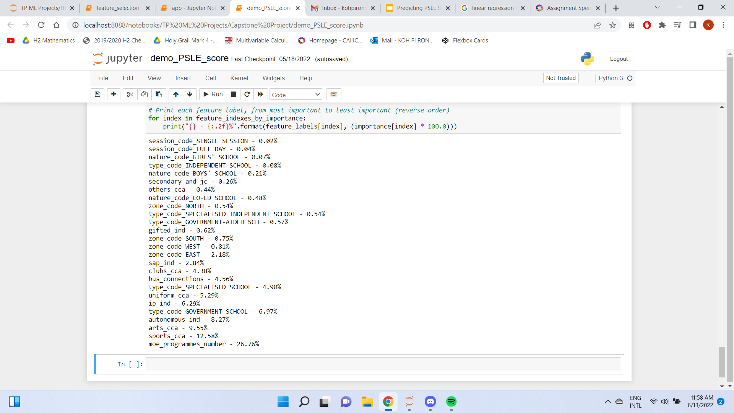
Insights
When each feature was ranked by importance, it was discovered that -
Gender of students mattered little to PSLE scores.
School autonomy (in designing curriculums), number of sports and arts CCAs, and MOE speciality programs significantly affect scores. This may be because they are a proxy indicator of school funding.
Least Important Features
Most Important Features

Slide 9
Conclusion
Many features contribute to a good or desirable school. We can generate a machine learning regression model using features that indicate a school’s performance.
To enhance our model, we must
Process and clean data
Compare between models
Tune model hyperparameters

Slide 10
References
Slide 2
Ministry Of Education Singapore. New PSLE Scoring System. Retrieved June 13, 2022, from https://www.moe.gov.sg/microsites/psle-fsbb/psle/main.html
Ang, H. M. (2020, November 6). New PSLE Scoring System. Channel NewsAsia. Retrieved June 13, 2022, from https://www.channelnewsasia.com/singapore/moe-psle-new-scoring-system-secondary-1-cut-off-point-528911
Slide 3
Data.gov.sg. (2021, March 26). School Directory and Information. Retrieved June 13, 2022, from https://data.gov.sg/dataset/school-directory-and-information
Ministry Of Education Singapore (2021, April 27). List of Indicative PSLE Score Ranges for Individual Secondary Schools. Retrieved June 13, 2022, from https://www.moe.gov.sg/microsites/psle-fsbb/assets/infographics/transition-to-secondary-school/indicative-psle-score-ranges-for-individual-secondary-schools.pdf
Slide 8
Ministry Of Education Singapore (2022, February 23). Types Of Schools. Retrieved June 13, 2022, from https://www.moe.gov.sg/education-in-sg/our-schools/types-of-schools

Slide 11
Thank You

